Slide 1
Refactoring to a SOLID Foundation
Steve Bohlen
Senior Software Engineer
SpringSource/VMware

Slide 2


Slide 3


Slide 4
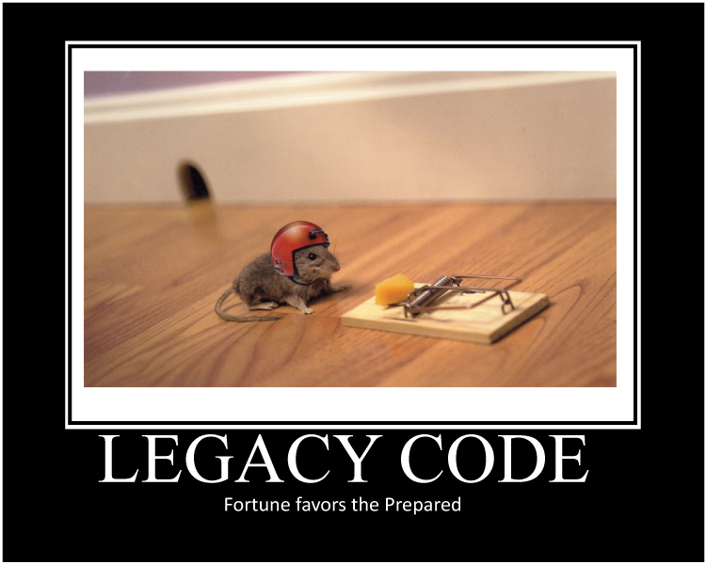

Slide 5


Slide 6
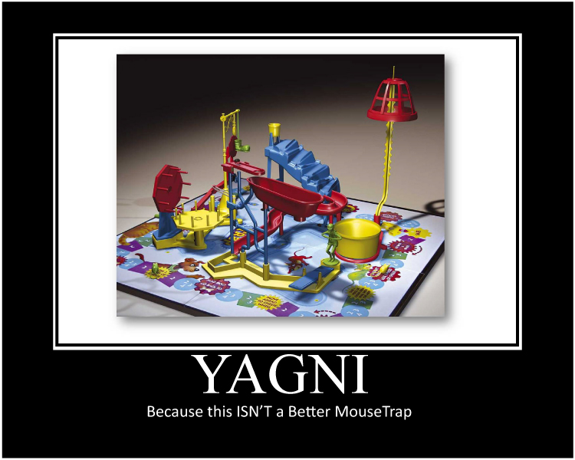

Slide 7
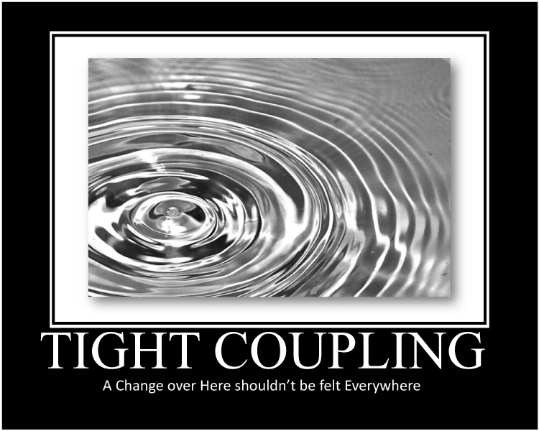

Slide 8
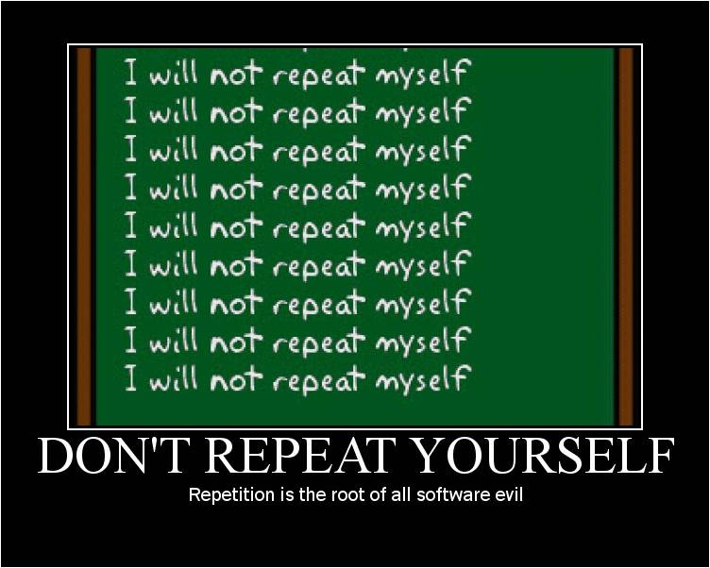

Slide 9
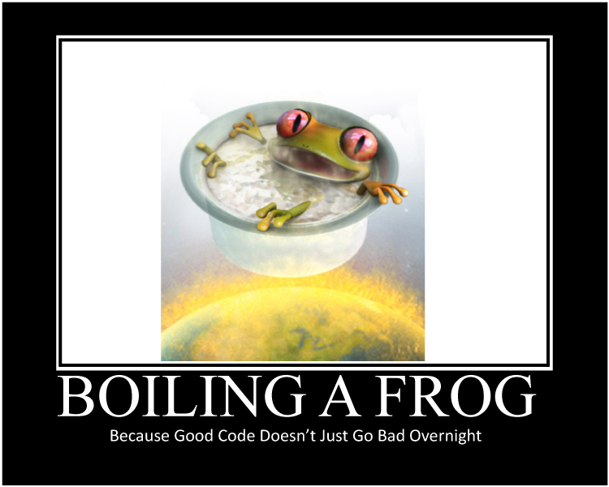

Slide 10
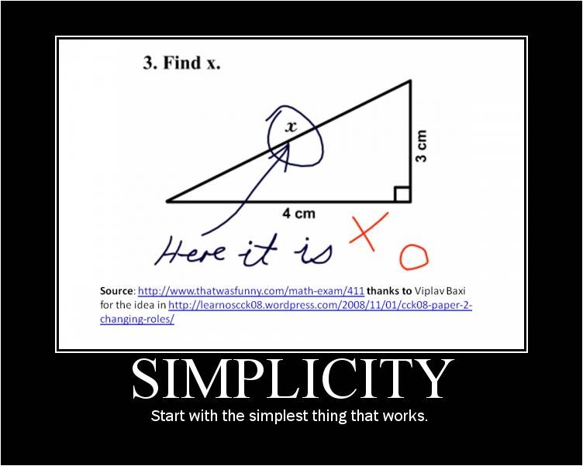

Slide 11
Refactoring
Disciplined technique
Restructuring an existing body of code
Altering its internal structure without changing its external behavior
A series of small behavior-preserving transformations
Each 'refactoring’ does little by itself
A sequence of transformations can produce a significant restructuring
Each refactoring is small so it's less likely to go wrong
The system is kept fully working after each small refactoring
Notes:
Refactoring is a disciplined technique for restructuring an existing body of code, altering its internal structure without changing its external behavior. Its heart is a series of small behavior preserving transformations. Each transformation (called a 'refactoring') does little, but a sequence of transformations can produce a significant restructuring. Since each refactoring is small, it's less likely to go wrong. The system is also kept fully working after each small refactoring, reducing the chances that a system can get seriously broken during the restructuring.

Slide 12


Slide 13
Refactoring Tools
Developer Express CodeRush
http://devexpress.com/coderush
JetBrains Resharper
http://www.jetbrains.com/resharper/
Visual Studio Professional

Slide 14
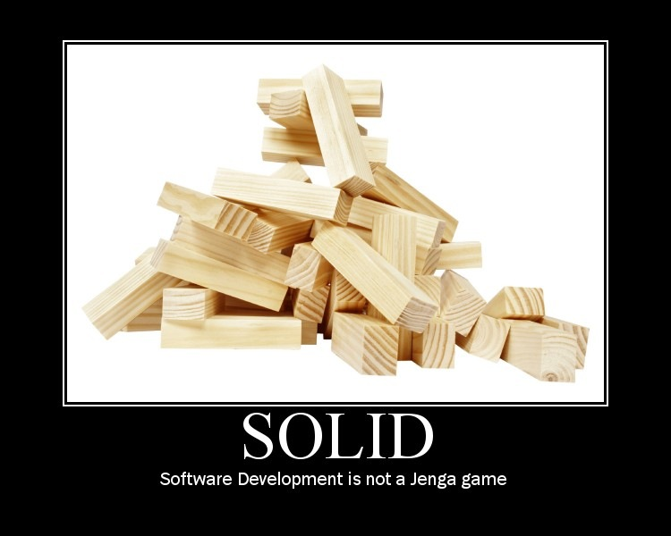

Slide 15
Introduction to S.O.L.I.D.
S
O
L
I
D
RP
ingle Responsibility Principle
CP
pen-Close Principle
SP
iskov Substitution Principle
SP
nterface Segregation Principle
IP
ependency Inversion Principle

Slide 16
Introduction to S.O.L.I.D.
S
O
L
I
D
ingle Responsibility Principle
pen-Close Principle
iskov Substitution Principle
nterface Segregation Principle
ependency Inversion Principle

Slide 17
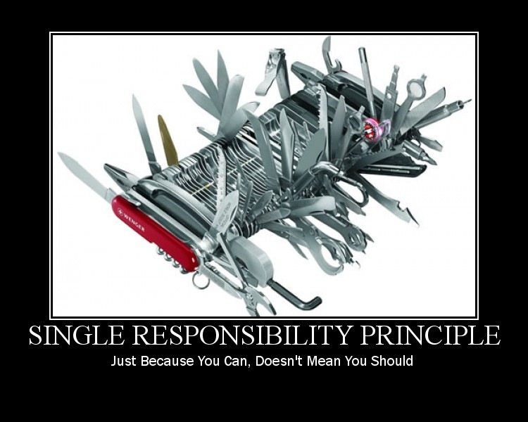

Slide 18
Single Responsibility Principle
There should never be more than one reason for a class to change.

Slide 19
Refactoring to a S.O.L.I.D. Foundation
SRP Demo

Slide 20
Introduction to S.O.L.I.D.
S
O
L
I
D
ingle Responsibility Principle
pen-Close Principle
iskov Substitution Principle
nterface Segregation Principle
ependency Inversion Principle

Slide 21
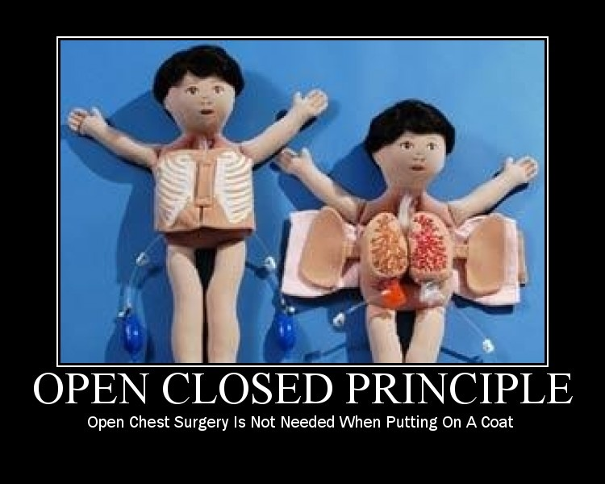

Slide 22
Open-Closed Principle
Software Entities (Classes, Modules, Functions, etc.)should be Open for Extension, but Closed for Modification.

Slide 23
Refactoring to a S.O.L.I.D. Foundation
OCP Demo

Slide 24
Introduction to S.O.L.I.D.
S
O
L
I
D
ingle Responsibility Principle
pen-Close Principle
iskov Substitution Principle
nterface Segregation Principle
ependency Inversion Principle

Slide 25
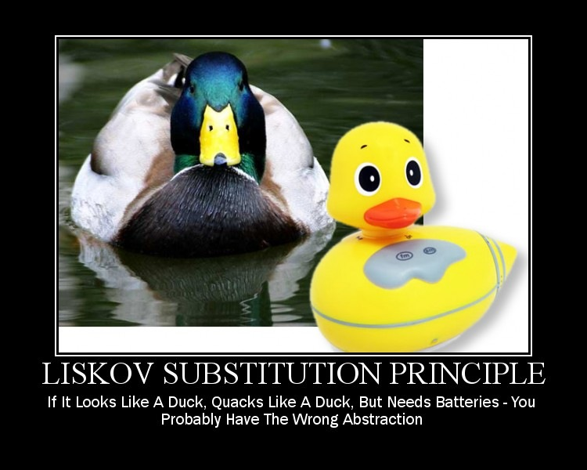

Slide 26
Liskov Substitution Principle
If for each object o₁ of type S
there is an object o₂ of type T such that
for all programs P defined in terms of T,
the behavior of P is unchanged when o₁ is substituted for o_{2,} then S is a subtype of T.
Huh ?!?

Slide 27
Liskov Substitution Principle
Functions that use pointers or references to base classes must be able to use objects of derived classes without knowing it.

Slide 28
Refactoring to a S.O.L.I.D. Foundation
LSP Demo

Slide 29
Introduction to S.O.L.I.D.
S
O
L
I
D
ingle Responsibility Principle
pen-Close Principle
iskov Substitution Principle
nterface Segregation Principle
ependency Inversion Principle

Slide 30
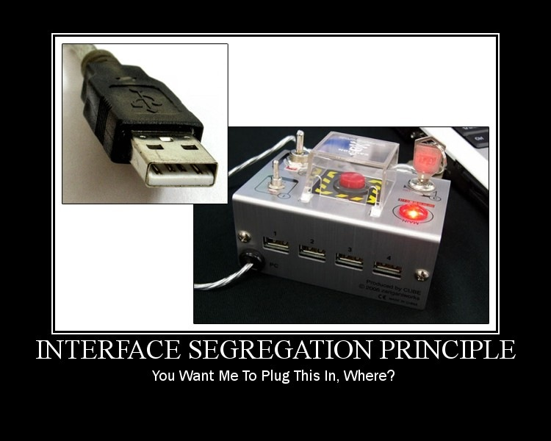

Slide 31
Interface Segregation Principle
Clients should not be forced to depend upon interfaces that they do not use.

Slide 32
Refactoring to a S.O.L.I.D. Foundation
ISP Demo

Slide 33
Introduction to S.O.L.I.D.
S
O
L
I
D
ingle Responsibility Principle
pen-Close Principle
iskov Substitution Principle
nterface Segregation Principle
ependency Inversion Principle

Slide 34
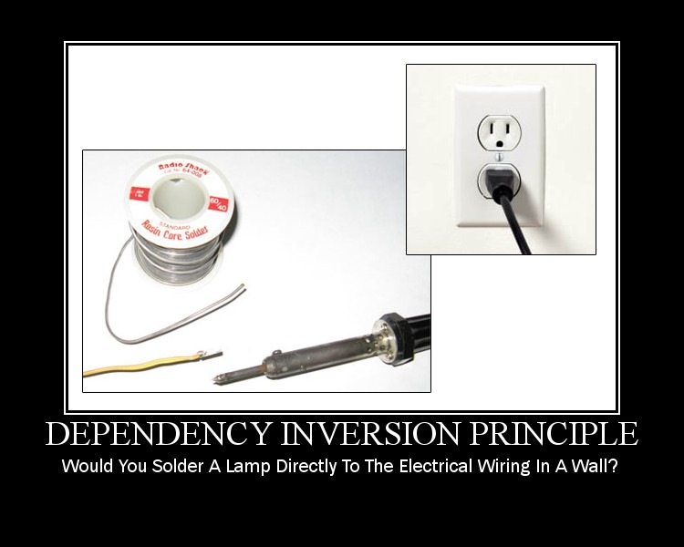

Slide 35
Dependency Inversion Principle
High Level Modules should not depend
upon Low Level Modules. Both should
depend upon abstractions.
Abstractions should not depend upon details. Details should depend upon abstractions.

Slide 36
Refactoring to a S.O.L.I.D. Foundation
DIP Demo

Slide 37
Refactoring to a S.O.L.I.D. Foundation
Closing Thoughts

Slide 38
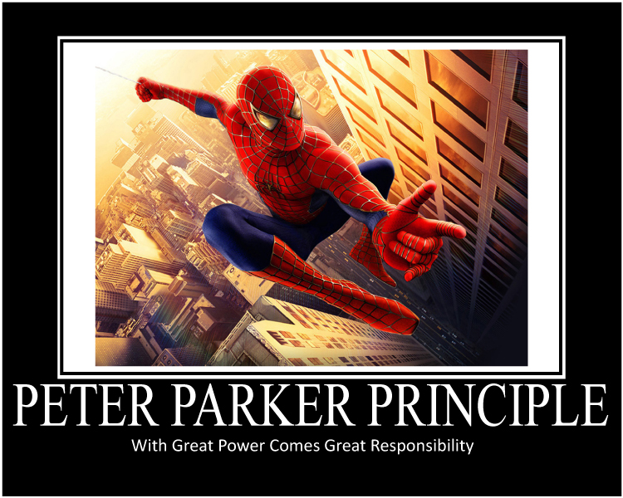

Slide 39
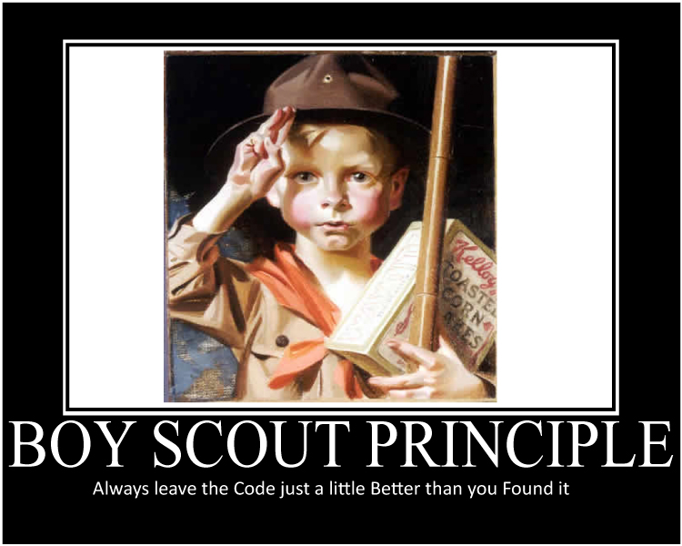

Slide 40
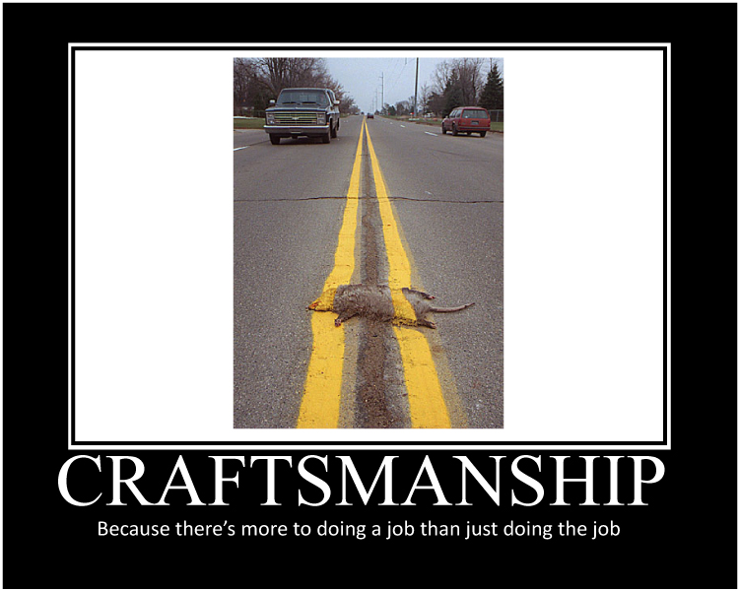

Slide 41
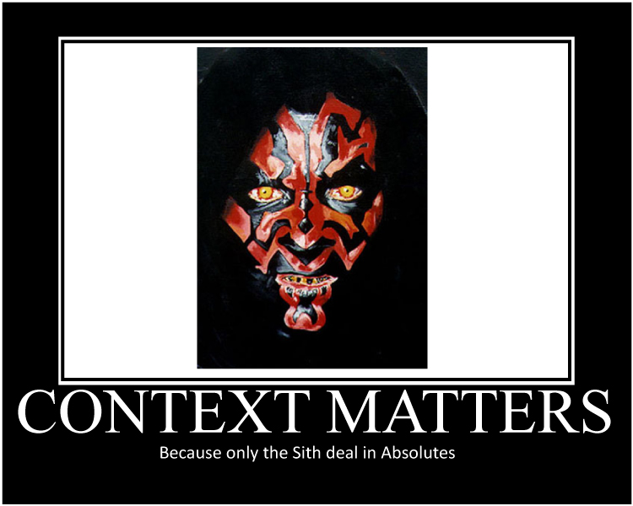

Slide 42
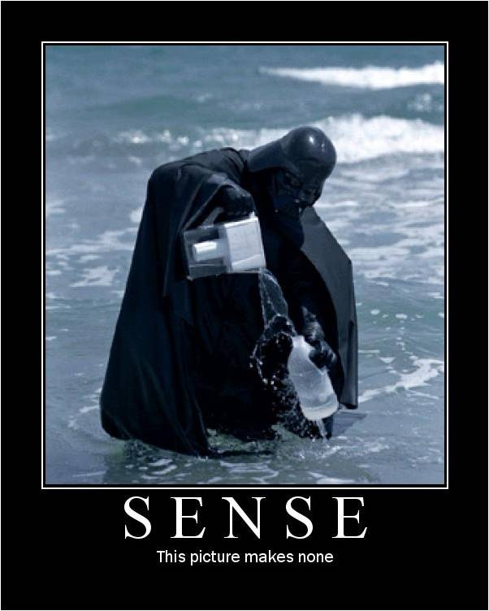

Slide 43
Refactoring to a S.O.L.I.D. Foundation
Fini

